Slide 1
POmics
Your Website for Protein Analysis & drug discovery

Slide 2
ABOUT US
Amera Mohamed Tasneem Zakarya Nadin Ahmed Fatma Ragab Yomna Othman

Slide 3
TABLE OF Basic CONTENTS
01
DNA file
03
Analysis &DotPlot
DrugDiscovery&visualization
02
Transcription &Translation
04

Slide 4
BRIEF OF THIS Project
Here’s what you’ll find in this POMICS website: * A slide bar showing our five pages showed in a website , which you can easily adapt to your needs. For more info on how to use the website, please visit https://github.com/YomnaOthmann/POMICS. - An Intro Page , which includes brief about website usage. so that proper use for data is given. - A DNA sequence Page , which you can upload your FASTA file and it shows protein synthesis operations such as : complement , AA frequency , etc . - An Example of COVID virus Page , which we applied the virus FASTA file , analyze it and extracted some info such as : most common amino acid , most common amino acid and polypeptide . -A DotPlot Page , which you can upload 2 FASTA files and shows its alignment score and also shows A plot for this Alignment . - A Molecular solubility Prediction Page , which shows the predicted visualized version of the molecular by passing the SMILES phase .

Slide 5
The Great Fun
Visualization
Tickles the eye and clarifies the information.

Slide 6
Take a look!
POMICS is waiting for you ;)

Slide 7
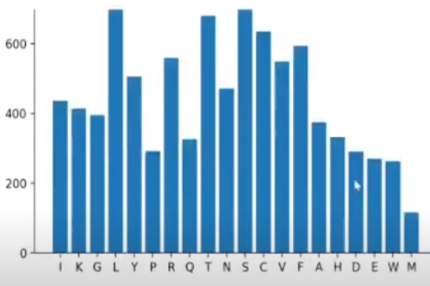

Slide 8
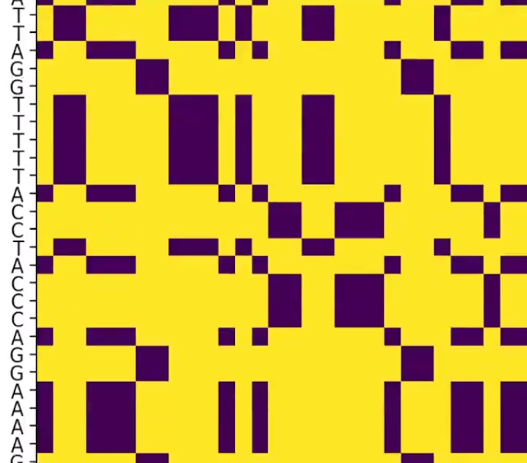

Slide 9
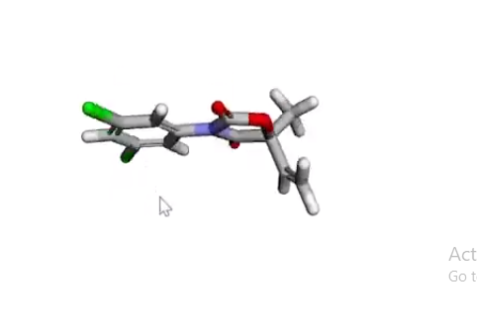
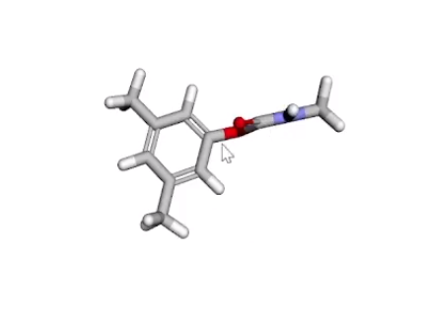
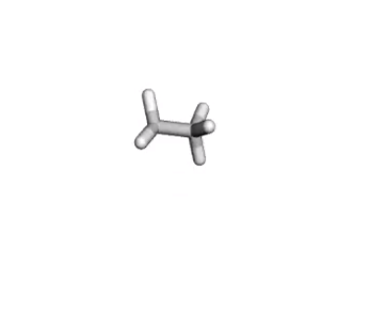

Slide 10
Predicted Solibility info Steps
Visualize the predicted one !
SMILES!
Show descriptors
Compute predicted LogS Values
1
2
3
4

Slide 11

STUDY HIGHLIGHTS
Do you know what our search inlayed during this project? Those triple P:
Pycharm Libraries Utilization (Streamlit,redkit,etc..).
Purification and analysis.
Plotting & visualization.
And the most important thing: the Patience and Team Work.

Slide 12
We are proud to be here!

Slide 13
CONTACT
fatmaragababdelaal@gmail.com iyomnaothman@gmail.com Tasneemmohamed1811@gmail.com Nadin.ahmed.2023@gmail.com ameraALsa3id@gmail.com

Slide 14
THANKS!
Do you have any questions?

